Slide 1



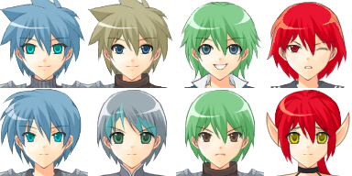
Cards
Pause
Gear
Social
Leaferson
Blade Master
12
645\1520
World
Options
Cards
View your cards, arrange your deck, and evolve your cards to make your character more powerful.
Save
/
Quit

